Slide 1
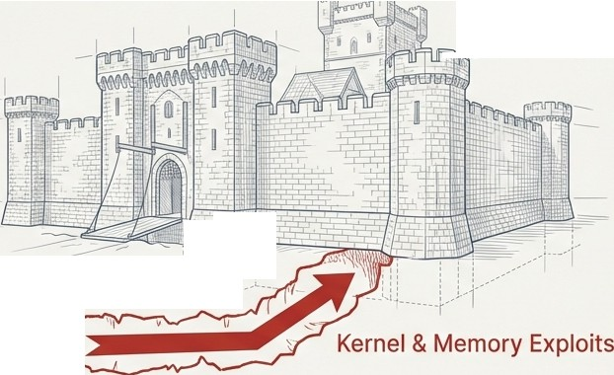

Your Hardened Linux Is Configured Correctly.
It's Also Fundamentally Vulnerable.
The industry standard for hardening is based on a flawed premise: that perfect configuration and rapid patching can achieve security. This reactive model leaves a permanent window of vulnerability to the most dangerous threats-those that operate below the configuration layer.
, / CIS / STIG Hardening
..:r
l:j'.. ,,
I
�-
0
'
'
_{I:}'
,_
..
--......�
Configuration-based hardening protects the perimeter. It does nothing to stop an attack from coming up through the floor.
Isl\ NotebookLM

Slide 2



The Reactive Security Model Guarantees Exposure.
The most critical vulnerabilities lie dormant for years before they are discovered, let alone patched. During this "silent vulnerability window," your systems are exposed, and your security posture is based on hope.
unique zero-days were exploited in 2023 alone.
•••••••••••••••••
•••••••••••••••••••••••••••••••••
••••••••••••••••••••••••••••
Case Study: CVE-2023-4911 'Looney Tunables'
Vulnerability introduced in glibc 2.34.
Qualys publicly discloses the vulnerability.
April 2021
November 2023 Exploit weaponized in the wild by Kinsing threat actors.
October 2023
I'S\ NotebookLM

Slide 3
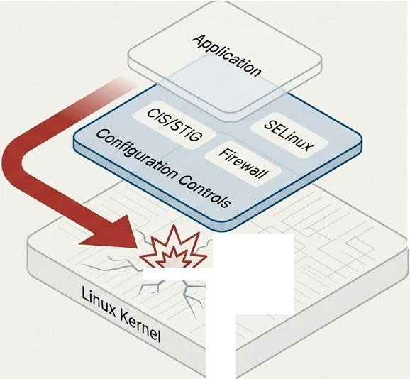
Configuration Can't Stop Kernel Exploits.
CIS Benchmarks and DISA STIGs are essential configuration checklists. They assume the kernel is trustworthy. When it's not, all higher-level
controls-SELinux, firewalls, file permissions-
become irrelevant. An attacker with a kernel exploit bypasses your entire configuration hardening framework.
The Lesson of Dirty COW (CVE-2016-5195) This critical privilege escalation bug bypassed all configuration-based security controls, including SELinux. Systems that were perfectly
"STIG-compliant" were completely completely vulnerable. This demonstrates a fundamental architectural weakness, not a configuration oversight.
Privilege Escalation
"7�-
Isl\ NotebookLM

Slide 4


Case Study: Mitigating an Actively Exploited Threat Before It Had a Name
Focus: CVE-2023-4911 ('Looney Tunable") - The only glibc CVE in this analysis that is actively exploited in the wild.
Risk Metrics
CVSS: 7.8 (High) - Local Privilege Escalation
EPSS: 88.8%
(Very High - 99.Sth percentile)
CISA KEV: LIActively Exploited
(Kinsing Threat Actor, Nov 2023)
''Our security-hardened glibc for EL9 distros... [has] a mitigation effective against CVE-2023-4911."
- Solar Designer, confirming the protection predated the CVE's public disclosure.
 | Standard Enterprise Linux RLC-H with Hardened glibc X VULNERABLE @ MITIGATED
Mechanism | GLIBC_TUNABLES GLIBC_TUNABLESis distrusted environment variable and stripped at the privilege processed by SUID binaries, boundary. The vulnerable code leading to buffer overflow. path is never reached.
Security Model | _{Reactive:Required an} Proactive:Protected by a _{emergency patch after the} security principle inherited from 2.5-year exposure window. ^{20+ years of Openwall/ALT} Linux hardening.
Isl\ NotebookLM

Slide 5
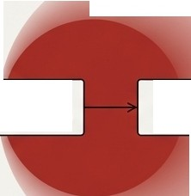


Case Study: How Architectural Hardening Defanged a CVSS 10.0 Supply Chain Attack
Focus: CVE-2024-3094 (The XZ Utils Backdoor)
We didn't patch this vulnerability faster. Our architecture, implemented 8 months earlier, made the attack fundamentally less dangerous.
Standard Architecture
RLC-H Architecture
...' ........................................................... .
.•
•
spawns temporary, sandboxed child process
.
 |  | � � liblzma
stemd
.
sshd
(main process)
sshd
(main process)
.
libsy
libsystemd
liblzma
(backdoor)
(backdoor)
.................................................................'.
Backdoor is contained to a limited-privilege child process.
Cannot intercept authentication. Blast radius reduced by ~80%.
Backdoor executes in main daemon. Full authentication bypass and system compromise.
(])
0
August 2023
RLC-H implements systemd isolation in OpenSSH.
March 29, 2024
XZ Backdoor is discovered.RLC-Hwasalready protected.
Isl\ NotebookLM

Slide 6



From Patching CVEs to Eliminating Vulnerability Classes
A reactive strategy means an endless cycle of patching individual bugs.
A proactive strategy eliminates the entire attack surface for entire classes of vulnerabilities.
Standard OpenSSH
libkrb5 libgssapi_krb5 libsystemd liblzma liblzma libzstd libncma libnarel libc libcrypto libssl libresolv
libnsl libcrypt libdl libpthread libutil
librt libpam liqselinl:JX. libsepol _libpcre2 libattr libcap l1bau�1t l1bdbu�-1 ll�gcrypt libgpg-error l1bmount l1bblk1d
libuuid
RLC-H Hardened OpenSSH
libc libnsl
libcrypto
libcrypt
libutil
libssl libdl librt
libresolv libpthread
libpam libselinux libsepol
Quantified Impact
Kerberos CVEs
ELIMINATED
RLC-H is 100% immune to CVE-2024-37370, CVE-2022-42898, CVE-2020-28196, and all
future Kerberos vulnerabilities.
systemd-related CVEs
CONTAINED
Blast radius for 6 documented CVEs is reduced by ~70%.
Reduction
in library dependencies
''Every removed library is a CVE you will never have to patch."
Isl\ NotebookLM

Slide 7


The RLC-H Proactive Security Stack
RLC-H integrates four layers of defense. While competitors stop at configuration, we provide three additional layers of runtime protection that actively prevent exploitation.
�::::::::;����7rt-- @ Configuration Hardening
CIS Benchmarks, DISA STIGs
Hardened Core Libraries [[JJ ----11+-++----++-H--,,<
glibc, OpenSSH
Reduces attack surface at
the source.
Establishes a secure baseline. (The Competitor's Entire Offer)
/,... .�
O Hardened Memory Allocator
hardened_malloc
Prevents heap corruption and memory exploits.
-+-+i-++-----1+--H'---
KernelRuntime Protection @ -----4,.i.....i/lr-��
Linux Kernel Runtime Guard (LKRG)
Detects and stops kernel-level
exploits in real time.
Isl\ NotebookLM

Slide 8




''Layer 1'': Linux Kernel Runtime Guard (LKRG) -
Real-Time Exploit Prevention
What It Is
A runtime guard that continuously monitors the kernel for signs of compromise, acting as an active defense against both known and zero-day exploits.
How It Protects Your Kernel
Integrity Checking: Continuously validates critical kernel structures, process credentials, and security feature states (e.g., SELinux enforcing).
Exploit Detection: Identifies common exploitation techniques, including privilege escalation,
control-flow hijacking, and credential tampering.
Proven Effectiveness
Successfully detects exploits for numerous historical kernel CVEs (e.g., BadlRET, waitid(2)).
Validated by independent academic research as a highly effective kernel rootkit detector.
RLC-H Integration
Enabled out-of-the-box, fully supported, signed for Secure Boot, and requires no manual compilation or maintenance. Performance overhead is a minimal ~2.5%.
Exploit Attempts
,,_.,._◄ ...⁻
...........
Linux Kernel
LKRG
Zero-Day Defense: Protects against classes of exploits, providing defense even before a specific vulnerability is known or patched.
0
Isl\ NotebookLM

Slide 9





Layer 2: hardened_malloc -
Threat.
Defusing the Memory Corruption
The Problem
60-70% of high-severity vulnerabilities are memory safety bugs (heap overflows, use-after-free, etc.). Configuration hardening offers zero protection against them.
How It Works
Buffer Overflow ,
-
Guard Guard
Page Page
Overflow
-----➔ Canary
x-
Overflow
Small Allocation
Memory Block
Memory Block
//
➔ D➔
free()
Allocation Heap
Metadata
Allocation
Underflow
/
_{X}�
J
CRASH
P@ssw0rdl
000900000000000-0
.......
\'\.
Check Failed
free()
Separated Metadata: Prevents buffer overflows from corrupting the allocator itself.
Guard Pages: Creates impassable memory barriers around large allocations to immediately detect overflows and underflows.
Canary Values: Places random values next to small allocations to detect corruption upon ·free()·.
Zero-on-Free: Wipes memory after use to prevent sensitive data leakage from use-after-free bugs.
Protection Against Common Exploit Primitives
Heap Overflows ✓ Use-After-Free
Double-Free
Heap Layout Manipulation
Isl\ NotebookLM

Slide 10


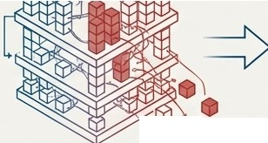
Layer 3: Hardened Libraries - Security Engineered at the Source
Our core libraries are not just patched-they are fundamentally re-architected based on a 20+ year security heritage from Openwall and ALT Linux.
Hardened glibc
Principle: Distrust environment variables at privilege boundaries.
Proof: This proactive principle mitigated the actively exploited "Looney Tunables" (CVE-2023-4911) before the vulnerability was public.
Impact: Eliminates an entire class of privilege escalation vectors, rather than patching individual bugs.
Hardened OpenSSH
Principle: Drastically reduce attack surface by removing non-essential code.
Proof: A 54% reduction in library dependencies provided immunity to all Kerberos CVEs and contained the XZ Backdoor.
Impact: Reduced operational burden and permanent immunity from entire classes of future vulnerabilities.
-➔)
Privileged Process
�·
I/
Original OpenSSH Dependencies
Discarded Code
/ Vulnerabilities
Hardened OpenSSH
I'S\ NotebookLM

Slide 11
The Difference is Architectural:
Proactive Prevention vs. Reactive Patching
Feature • CIS/STIG Compliance | Standard Hardened Linux (Competitors) | RLC-H | Advantage - Parity
 | LIYes | ti Yes LILKRG
Kernel Runtime Protection | XNone |  | RLC-H: Zero-Day Exploit Prevention
Memory Corruption Hardening | XNone | LI hardened_malloc | RLC-H: Heap Exploit Mitigation
OpenSSHDependencies | 28 Libraries | 13 Libraries Pre-Mitigated | RLC-H: 54% Attack Surface Reduction
CVE-2023-4911 (Looney Tunables) | Required Emergency Patch |  | RLC-H: Proactive Immunity
CVE-2024-3094 (XZ Backdoor) | Architecturally Vulnerable | Blast Radius Contained | RLC-H: ~80% Risk Reduction
Security Model | ^{REACTIVE PROACTIVE} Fundamental Superiority (Patch known threats) (Prevent unknown threats)
I'S\ NotebookLM

Slide 12






Quantifying the Value: From Technical Superiority to Operational Efficiency.
Proactive hardening doesn't just reduce risk; it eliminates entire categories of operational work, freeing your security team from an endless cycle of reactive patching.
Annual Remediation Cost Avoidance
Focus: Kerberos CVEs in OpenSSH.
Emergency Response Cost Avoidance
Focus: CVE-2023-4911('Looney Tunables').
)
)
Standard Linux Burden
18-64 hours
RLC-H Burden
0 hours
Standard Linux Cost
22-44 hours
RLC-H Cost
$0
Annual Savings:
$1,350 - $9,600
Costing $3,300 - $13,200 for a single high-profile CVE.
in engineering time, multiplied across your fleet.
RLC-H transforms security maintenance from a chaotic, reactive fire drill into a predictable, managed process.
I'S\ NotebookLM

Slide 13


The ROI of Preventing a Single Breach
The cost of configuration-only hardening is measured not by its license fee, but by the cost of the breach it cannot prevent.
The Cost of a Successful Kernel Exploit
{on a CIS-Hardened System)
Incident Response
& Forensics
The RLC-H Value Proposition
Return: Avoiding a multi-million dollar incident.
System Rebuild & Remediation
Investment:
The premium for proactive hardening.
$50k- $200k
$20k- $100k
Emergency Patching Labor
[ $10k - $50k ]
Total Direct Cost
$80k - $350k+
Indirect & Business Costs
Break-Even Analysis
If RLC-H's proactive layers prevent one major security incident every 2-3 years, the investment pays for itself many times over.
IL\
\.@
Downtime&
Revenue Loss
h Regulatory Fines
� (GDPR, PCI DSS)
(l.s, Reputation &
\Y Customer Trust
Damage
I'S\ NotebookLM

Slide 14




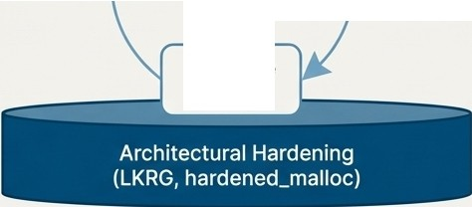


A Fundamental Choice: Stay in the Reactive Cycle or Move to Proactive Defense
The Reactive Cycle (The Past) The Proactive Model (The Future with RLC-H)
Vulnerability Disclosed
CVE
Disclosed
Assess Impact
Scan &
Identify
Wait for Next CVE
Schedule Patch
Emergency Patch
"Our security is defined by how fast we can patch what the world already knows is broken."
"Our security is defined by our resilience to threats we haven't seen yet."
Compliance gets you through the audit. Proactive hardening keeps you out of the breach headlines.
I'S\ NotebookLM

